Slide 1
Law Of Demand
According to the law of demand, other things being equal, if the price of a commodity falls, the quantity demanded of it will rise and if the price of a commodity rises, its quantity demanded will decline.
The Law of Demand may be illustrated with the help of a demand schedule and a demand curve.
Demand Schedule A demand schedule is a table which presents the different prices of a good and the corresponding quantity demanded per unit of time.

Slide 2
Demand schedule of an individual consumer
 | Price (in Rupees) | Quantity demanded (Units)
A | 5 | 10
B | 4 | 15
C | 3 | 20
D | 2 | 35
E | 1 | 60

Slide 3
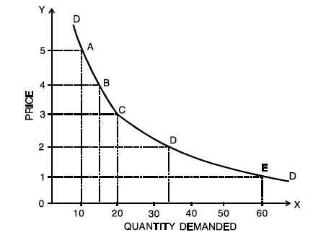
Demand Curve:
A demand curve is a graphical presentation of the demand schedule. It is obtained by plotting a demand schedule.

Slide 4
Market Demand Schedule
Market demand is defined as the sum of individual demands for a product at a price per unit of time. In other words, it is the total quantity that all consumers of a commodity are willing to buy per unit of time at a given price, all other things remaining constant.
When we add up the various quantities demanded by different consumers in the market, we can obtain the market demand schedule.

Slide 5
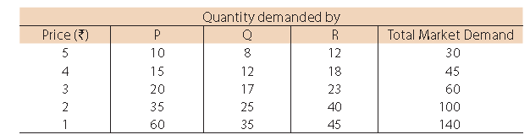

Slide 6
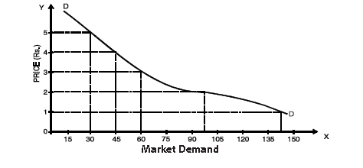
Market Demand Curve:
If we plot the market demand schedule on a graph, we get the market demand curve.

Slide 7
Elasticity Of Demand
Elasticity of demand is defined as the responsiveness of the quantity demanded of a good to changes in one of the variables on which demand depends.
More precisely, elasticity of demand is the percentage change in quantity demanded divided by the percentage change in one of the variables on which demand depends.
These variables are price of the commodity, prices of the related commodities, income of the consumers and other factors on which demand depends.

Slide 8
Thus, we have price elasticity, cross elasticity, income elasticity, advertisement elasticity and elasticity of substitution.
It is to be noted that when we talk of elasticity of demand, unless and until otherwise mentioned, we talk of price elasticity of demand.
In other words, it is price elasticity of demand which is usually referred to as elasticity of demand.

Slide 9

Price Elasticity
Price elasticity of demand expresses the response of quantity demanded of a good to a change in its price, given the consumer’s income, his tastes and prices of all other goods.
In other words, it is measured as the percentage change in quantity demanded divided by the percentage change in price, other things remaining equal. That is,

Slide 10
Change in Quantity
-------------------------- X100
Original Quantity Change in Quantity Original Price
Ep = ----------------------------------- OR --------------------------- X ---------------------
Change in Price Original Quantity Change in Price
----------------------X100
Original Price

Slide 11
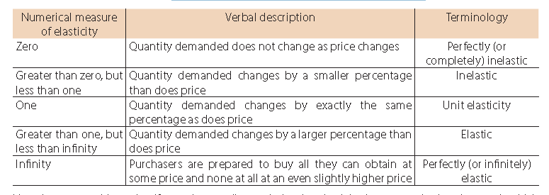
Elasticity measures, meaning and nomenclature

Slide 12
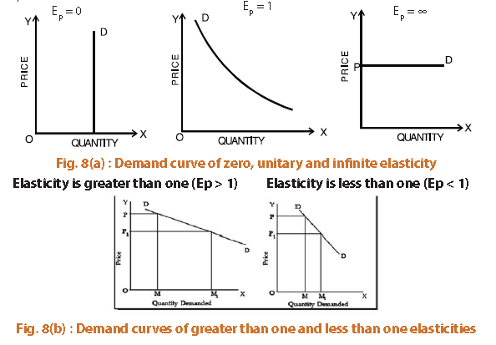

Slide 13
Point elasticity:
In point elasticity, we measure elasticity at a given point on a demand curve. The concept of point elasticity is used for measuring price elasticity where the change in price is infinitesimal.
Point elasticity makes use of derivative rather than finite changes in price and quantity.
It may be defined as:
-dq p
Ep = ------ - × -------
dp q
where dq /dp is the derivative of quantity with respect to price at a point on the demand curve, and p and q are the price and quantity at that point.
.

Slide 14
Point elasticity is, therefore, the product of price quantity ratio at a particular point on the demand curve and the reciprocal of the slope of the demand line.

Slide 15
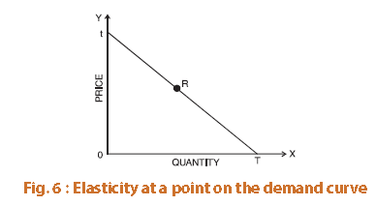
Thus elasticity is different at different points on the same demand curve. Given a straight line demand curve tT, point elasticity at any point say R can be found by using the formula
RT lower segment
----- = --------------------
Rt upper segment

Slide 16
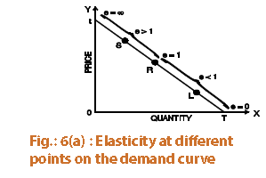
Using the above formula we can get elasticity at various points on the demand curve.
Thus, we see that as we move from T towards t, elasticity goes on increasing. At the mid-point it is equal to one, at point t it is infinity and at T it is zero.

Slide 17
Arc-elasticity:
When the price change is somewhat larger or when price elasticity is to be found between two prices [or two points on the demand curve say, A and B in figure 7], the question arises which price and quantity should be taken as base. This is because elasticities found by using original price and quantity figures as base will be different from the one derived by using new price and quantity figures. Therefore, in order to avoid confusion, generally mid-point method is used i.e. the averages of the two prices and quantities are taken as (i.e. original and new) base. The arc elasticity can be found out by using the formula:
q1 – q2 p1 + p2
Ep = ----------- × ------------
q1 + q2 p1 - p2
where p1, q1 are the original price and quantity and p2, q2 are the new ones.

Slide 18
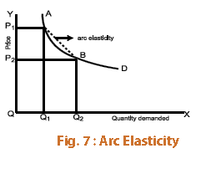

Slide 19
Income Elasticity of Demand :
Income elasticity of demand is the degree of responsiveness of quantity demanded of a good to changes in the income of consumers. In symbolic form
Percentage change in demand
Ei = -----------------------------------------
Percentage change in income
ΔQ Δ Y
Ei = ------ ÷ -------
Q Y
ΔQ Y
= ------ X -------
Q Δ Y
ΔQ Y
= ------ X -------
Δ Y Q

Slide 20
Ei = Income elasticity of demand
Δ Q = Change in demand
Q = Original demand
Y = Original money income
Δ Y = Change in money income
If the proportion of income spent on a good remains the same as income increases, then income elasticity for the good is equal to one.
If the proportion of income spent on a good increase as income increases, then the income elasticity for the good is greater than one.
If the proportion of income spent on a good decrease as income rises, then income elasticity for the good is less than one.

Slide 21
Knowledge of income elasticity of demand is very useful for a business firm in estimating future demand for its products. Knowledge of income elasticity of demand helps firms predict the outcome of a business cycle on its market demand. This enables the firm to carry out appropriate production planning and management.

Slide 22
Cross Elasticity of Demand
Price of Related Goods and Demand: The demand for a particular commodity may change due to changes in the prices of related goods. These related goods may be either complementary goods or substitute goods. This type of relationship is studied under ‘Cross Demand’. Cross demand refers to the quantities of a commodity or service which will be purchased with reference to changes in price, not of that particular commodity, but of other inter-related commodities, other things remaining the same. It may be defined as the quantities of a commodity that consumers buy per unit of time, at different prices of a ‘related article’, ‘other things remaining the same’. The assumption ‘other things remaining the same’ means that the income of the consumer and also the price of the commodity in question will remain constant.

Slide 23
Substitute Products
In the case of substitute commodities, the cross demand curve slopes upwards (i.e. positively) showing that more quantities of a commodity, will be demanded whenever there is a rise in the price of a substitute commodity.
In figure 9, the quantity demanded of tea is given on the X axis. Y axis represents the price of coffee which is a substitute for tea. When the price of coffee increases, due to the operation of the law of demand, the demand for coffee falls. The consumers will substitute tea in the place of coffee. The price of tea is assumed to be constant.

Slide 24
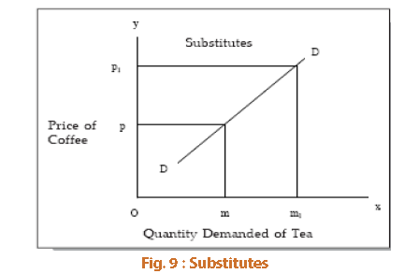
Therefore, whenever there is an increase in the price of one commodity, the demand for the substitute commodity will increase.

Slide 25
Complementary Goods
In the case of complementary goods, as shown in the figure below, a change in the price of a good will have an opposite reaction on the demand for the other commodity which is closely related or complementary.
For instance, an increase in demand for pen will necessarily increase the demand for ink.
The same is the case with complementary goods such as bread and butter; car and petrol electricity and electrical gadgets etc. Whenever there is a fall in the demand for fountain pens due to a rise in prices of fountain pens, the demand for ink will fall, not because the price of ink has gone up, but because the price of fountain pen has gone up.
So, we find that there is an inverse relationship between price of a commodity and the demand for its complementary good (other things remaining the same).

Slide 26
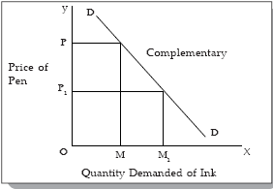
Complementary Goods

Slide 27
The concept of cross elasticity of demand is useful for a manager while making decisions regarding changing the prices of his products which have substitutes and complements.
If cross elasticity to change in the price of substitutes is greater than one, the firm may lose by increasing the prices and gain by reducing the prices of his products.
With proper knowledge of cross elasticity, the firm can plan policies to safeguard against fluctuating prices of substitutes and complements.

Slide 28
Advertisement Elasticity
Advertisement elasticity of sales or promotional elasticity of demand is the responsiveness of a good’s demand to changes in firm’s spending on advertising.
The advertising elasticity of demand measures the percentage change in demand that occurs given a one percent change in advertising expenditure.
Advertising elasticity measures the effectiveness of an advertisement campaign in bringing about new sales.
Advertising elasticity of demand is typically positive. Higher the value of advertising elasticity greater will be the responsiveness of demand to change in advertisement.

Slide 29
Advertisement elasticity varies between zero and infinity. It is measured by using the formula;
% Change in demand
Ea =-------------------------------------------------
% change in spending on advertising
ΔQd /Qd
Ea = -------------
Δ A/ A
Where : Δ Qd denotes change in demand.
Δ A denotes change in expenditure on advertisement.
Qd denotes initial demand.
A denotes initial expenditure on advertisement
Elasticity Interpretation :
Ea = 0 Demand does not respond to increase in advertisement expenditure.

Slide 30
Ea >0 but < 1 Change in demand is less than proportionate to the change in advertisement expenditure.
Ea = 1 Demand changes in the same proportion in which advertisement expenditure changes.
Ea > 1 Demand changes at a higher rate than change in advertisement expenditure.
As far as a business firm is concerned, the measure of advertisement elasticity is useful in understanding the effectiveness of advertising and in determining the optimum level of advertisement expenditure.

